Slide 1


Parking System
Name –

Slide 2
What is Java?
It is an object-oriented language developed by Sun in the mid 1990s.
Original language called Oak
Intended for embedded systems
Unlike C++, it was developed from scratch.
The syntax is very similar to C.
Sun describes it as
"A simple, object-oriented, distributed, interpreted, robust, secure, architecture neutral, portable, high-performance, multi-threaded and dynamic language."

Slide 3
What is Java? (cont)
Object-Oriented
Designed to support Object-Oriented concepts
However, does contain non-Object-Oriented primitive data types
Distributed
Applications are constructed using objects. Objects can be distributed in multiple locations within a network environment.
Extensive integration with TCP/IP

Slide 4
What is Java? (cont)
Robust
Memory management is done automatically
Use of pointers is limited
Secure
All Java code subject to security model.
Architecture-Neutral/Portable
Compiled Java (byte code) will run on any platform which has a Java Virtual Machine
The Java Virtual Machine is available for almost all platforms...

Slide 5
What is Java? (cont)
High-Performance
Originally, Java's performance was poor.
Now, Java's performance rivals C++.
Multi-Threaded
Processes contain multiple threads of execution.
Similar to multi-tasking but all threads share the same memory space.
Dynamic
Makes heavy use of dynamic memory allocation.
Classes can be dynamically loaded at any time.

Slide 6
Platform Independence. How does Java do it?
Java has been described as WORA (Write once, Run Anywhere)
In most cases, this is true.
Not always true with GUI.
Doesn't always come for free. Can require a lot of testing.
Because Java source code is compiled to byte code and the byte code is interpreted, Java code can be executed anywhere an interpreter is available.
The "Interpreter" is call the Java Virtual Machine

Slide 7
The Java Virtual Machine.
Traditionally, source code had to be compiled for the target hardware and OS platform:
Windows
Compiler
i386 binary
Solaris
Compiler
SPARC binary
Source.cpp
Mac
Compiler
PPC binary

Slide 8
The Java Virtual Machine.
Java source files (.java) are compiled to Java bytecode (.class)
Bytecode is interpreted on the target platform within a Java Virtual Machine
i386 VM
Source.java
Java
Compiler
Java
Bytecode
Source.class
SPARC VM
PPC VM

Slide 9
The Java Software Development Kit (SDK)
The Java SDK comes in three versions:
J2ME - Micro Edition (for handheld and portable devices)
J2SE - Standard Edition (PC development)
J2EE - Enterprise Edition (Distributed and Enterprise Computing)
The SDK is a set of command line tools for developing Java applications:
javac - Java Compiler
java - Java Interpreter (Java VM)
appletviewer - Run applets without a browser
javadoc - automated documentation generator
jdb - Java debugger

Slide 10
Introduction of Project
Now days in many public places such as malls, multiplex systems, hospitals, offices, market areas there is a crucial problem of car parking. The car-parking area hasmany lanes/slots for car parking. So to park a car one has to look for all the lanes. Moreover this involves a lot of manual labour and investment. So there is a need to develop an automated parking system that indicates directly the availability of vacant parking slots in any lane right at the entrance. The project involves a system including infrared transmitter- receiver pair in each lane and an LED/ LCD display outside the car parking gate. So the person desirous to park his vehicle is well informed about the status of availability of parking slot.Conventional parking systems do not haveany intelligent monitoring system and the parking lots are monitored by security guards. A lot of time is wasted in searching vacant slot for parking and many a times it creates jams. Conditions becomeworse when there are multipleparking lanes and each lane with multiple parkingslots. Useofparking management system would reduce the human efforts and time with additional comfort. In the proposed system, the display unit and the LEDsindicate the status of the parking lanes viz. a GREEN LED indicates a vacant slotand a RED LED indicates the unavailability. The system would not only save time but the software and hardware would also manage the Check-in and check-outs of the cars under the control of RFID readers/ tags with additional features of automatic billing, green communication, entry/exit data logging and obstacle indication during parking using ultrasonic sensors.

Slide 11
Modules of the software:
Books:Admin has the authority to add, delete or modify the details of the book available to/from the system.
Library Registration:The first procedure is the registration of the people who arrive to the library. The receptionist has the authority to enter the name, address and contact number of the people who visit the library along with the name of the book they want to read.
Time spent: Their entry and exit time to the library will be noted down. This calculates the total amount of time they spent in library.
Purchase books:Admin can also add the details of the book purchased from shops along with the shop name. He also has the authority to delete from or modify it to the database.
Borrow books:A person can also borrow the book for particular days. All the information will be entered in the system. If the person doesn’t return the book before the due date, a fine will be added and the information will be sent to that particular person about the fine.
Login registration:Admin also has the authority to provide username and password for the receptionist.
Reports:Monthly expense report, books purchased report, cash collected for fee can also be viewed.

Slide 12
Literature Survey
The concept of the automated parking system is driven by two factors: need for parking space and scarcity of available land.The earliest use of an Automated parking system(APS) was in Paris, France in 1905 at the Garage Rue de Pontius[1].The APS consisted of a groundbreaking multi-story concrete structure with an internal elevator to transport cars to upper levels where attendants parked the cars[2]. In the 1920s, a Ferris wheel-like APS (for cars rather than people) called a paternoster system became popular as it could park eight cars in the ground space normally used for parking two cars. Mechanically simple with a small footprint, the paternoster was easy to use in many places, including inside buildings. In 1957, 74 Bowser, Pigeon Hole systems were installed, and some of these systems remain in operation. However, interest in APS in the U.S. waned due to frequent mechanical problems and long waiting times for patrons to retrieve their cars[3]. Interest in APS in the U.S. was renewed in the 1990s, and there are 25 major current and planned APS projects (representing nearly 6,000 parking spaces) in 2012 [4]. While interest in the APS in the U.S. languished until the

Slide 13
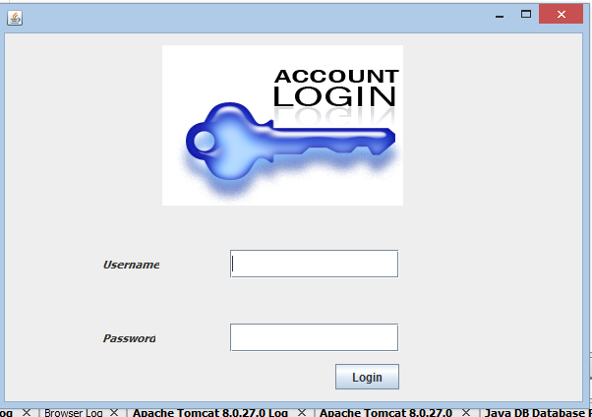

Slide 14
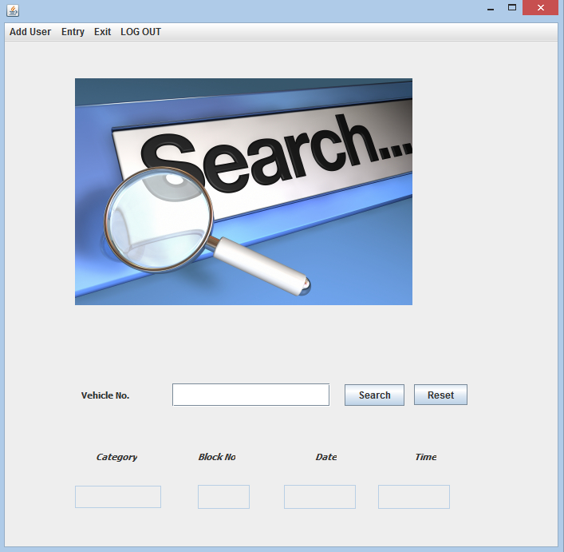

Slide 15
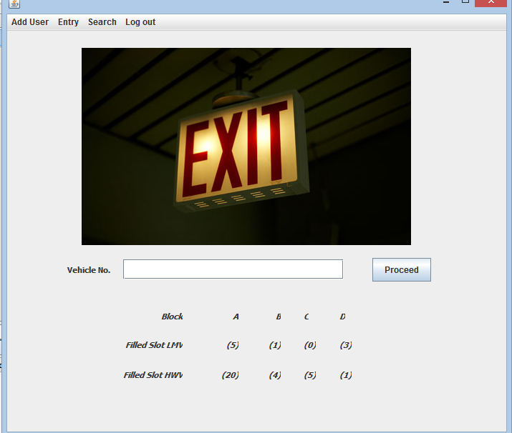

Slide 16
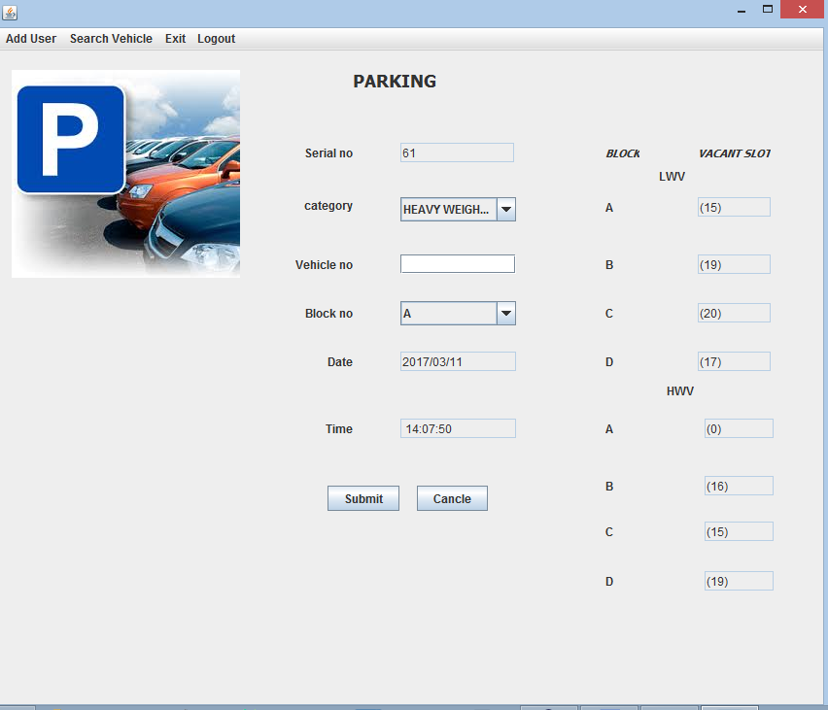

Slide 17
Thank You

